Slide 1
Accelerating Systems with Programmable Logic Components Lecture 04 Verilog II
1DT109 ASPLOC
2022 VT1-VT2
Yuan Yao, yuan.yao@it.uu.se
Courtesy to Philipp Rümmer

Slide 2
Agenda
Review module-based modelling in Verilog
Combinational vs. sequential logic
Blocking vs. nonblocking assignment
Writing testbench using Verilog

Slide 3
Module-based modelling in Verilog
my_module
module my_module(A, B, C, O);
input A, B, C;
output O;
wire w_not, w_and1, w_and2;
not Not1(.out(w_not), .in1(C));
and And1(.out(w_and1), .in1(A), .in2(w_not));
OR
assign O = (A & ~C) | (B & C);
endmodule
A
And1
input/output port definition
B
Not1
Or1
O
And2
C
This is for combinational logic.
connecting wire
my_module
declaration
gate-level modeling
data-flow level modeling

Slide 4
Combinational vs Sequential logic
Combinational logic is defined as the time independent logic which do not depends upon previous inputs to generate any output.
Examples – Encoder, Decoder, Multiplexer, Demultiplexer
Sequential logic is a type of logic circuit whose output depends not only on the present value of its input signals but on the sequence of past inputs, the input history as well.
Examples – Flip-flops, counters, memory

Slide 5
Sequential logic example: counter
Input
Adder
(combinational logic)
Output = Input + 1
Output = Cur + 1
Mem component
such as Flip-Flop
(sequential logic)
clk

Slide 6
Sequential logic example: critical path break
Combinational logic
input
output
Speed/area tread off.
Delay=X > threshold
Combilogic
Combilogic
input
FF
output
Delay=X/2 < threshold
Delay=X/2 < threshold

Slide 7
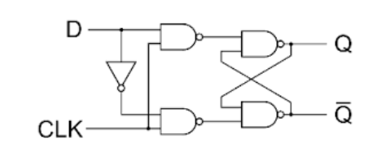
Model flip-flop (FF) using Verilog
Step 1: Find the schema of an FF
Step 2: Use gate-level or data-flow level modeling for FF
Do we have other options?
D
D_FF
Q
clk

Slide 8
Model flip-flop (FF) using Verilog
We can use RTL-level modeling in Verilog to model FF
The recommended way to model combinational logic in Verilog
module d_ff(clk, D, Q);
input clk, D;
output Q;
reg Q;
always @ (posedge clk) begin
Q <= D;
end
endmodule
D
D_FF
Q
clk

Slide 9
The always block
An always block is one of the procedural blocks in Verilog.
Statements inside an always block are executed sequentially.
But they may take effect simultaneously
a=1;
b=2;
always @ (a, b) begin
a <= b;
b <= a;
end // a=2, b=1;
a=1;
b=2;
always @ (a, b) begin
a = b;
b = a;
end // a=2, b=2;

Slide 10
The sensitivity list
A sensitivity list is the expression that defines when the always block should be executed and is specified after the @ operator within parentheses ( ).
Sensitivity list is the key to differentiate combinational logic and sequential logic.
Rules of thumb No.1:
Put all input signals into the sensitivity list for combinational logic
Put only the clock (and reset if needed) signal into the sensitivity list for sequential logic
Execute always block whenever value of “a” or “b” change – combinational logic
Execute always block only on the rising edge of signal clk – sequential lock
always @ (a, b)
begin
c = a | b;
end
always @ (posedge clk)
begin
c <= a | b;
end
Can also use negedge
for falling edge

Slide 11
The reg data type (vs wire)
Verilog data types are divided into two main groups: nets (wire) and variables (reg). The distinction comes from how they are intended to represent different hardware structures.
A net (wire) data type represents a physical connection between structural entities. (Recall the my_module example)
A variable (reg) data type represents a piece of storage.
Rules of thumb No.2:
Drive a Verilog wire with assign statement or port output
Drive a Verilog reg from an always block.
wire c;
assign c = a | b;
reg c;
always @ (a, b)
begin
c = a | b;
end
reg c;
always @ (posedge clk)
begin
c <= a | b;
end

Slide 12
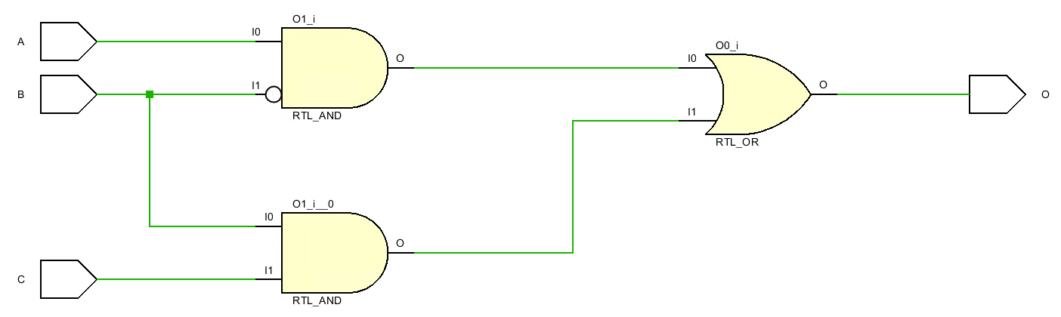

Demo 1
my_module
A
And1
B
Not1
my_module from Verilog I using always block
Or1
O
And2
C
module demo_1(A,B,C,O);
input A, B, C;
output O;
assign O = reg_o;
reg reg_o;
always @ (A, B, C) begin
reg_o = A & ~B | B & C;
end
endmodule
$O=A∙\overline{C}+$ $B∙C$

Slide 13
Putting them all together
Q only reflects the value of D on a rising edge
Rising edge means 0 in the past of input and 1 in the current
module d_ff(clk, D, Q);
input clk, D;
output Q;
reg Q;
always @ (posedge clk) begin
Q <= D;
end
endmodule
Can also use non-clock signals as trigger
D
D_FF
Q
clk

Slide 14
D_FF with synchronous reset
Add a reset to the D_FF
Synchronous reset means that the D_FF can only be reset on clock edge (in our case, a rising edge)
module d_ff(clk, D, Q);
input clk, D;
output Q;
reg Q;
always @ (posedge clk) begin
if(!reset)
Q <= 1’b0;
else
Q <= D;
end
endmodule
How to add asynchronous reset?
D
D_FF
Q
reset
clk
Added gates!

Slide 15
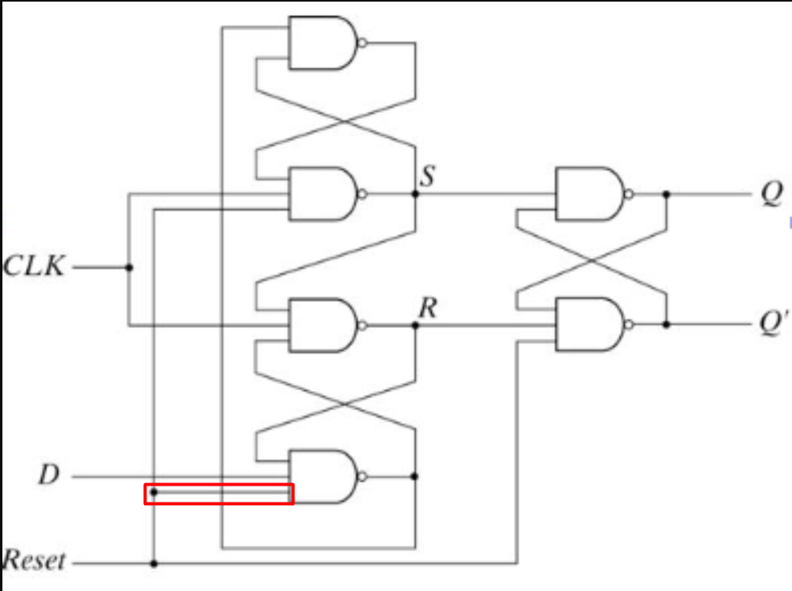
D_FF with asynchronous reset
Add a reset to the D_FF
Asynchronous reset means that the D_FF can be reset on reset edge (in our case, a falling edge)
Always use asynchronous D_FF.
It keeps your datapath shorter/faster.
(why???)
module d_ff(clk, D, Q);
input clk, D;
output Q;
reg Q;
always @ (posedge clk, negedge reset) begin
if(!reset)
Q <= 1’b0;
else
Q <= D;
end
endmodule
D
D_FF
Q
clk
No added gates needed!
reset

Slide 16
Blocking vs. non-blocking assignment
Rules of thumb No.3:
Use blocking assignment to model combinational logic.
Use non-blocking assignment to model sequential logic.
Different ways to drive wire and reg.
= is called blocking assignment.
Blocking assignment executes “in series” because a blocking assignment blocks execution of the next statement until it completes.
<= is called non-blocking assignment.
Non-blocking assignment executes “in parallel” because it describes assignments that all occur at the same time.
Bad styles can lead to both buggy and incorrect circuit.
Blocking assignment
Non-blocking assignment
wire c;
assign c = a | b;
reg c;
always @ (a, b)
begin
c = a | b;
end
reg c;
always @ (posedge clk)
begin
c <= a | b;
end

Slide 17
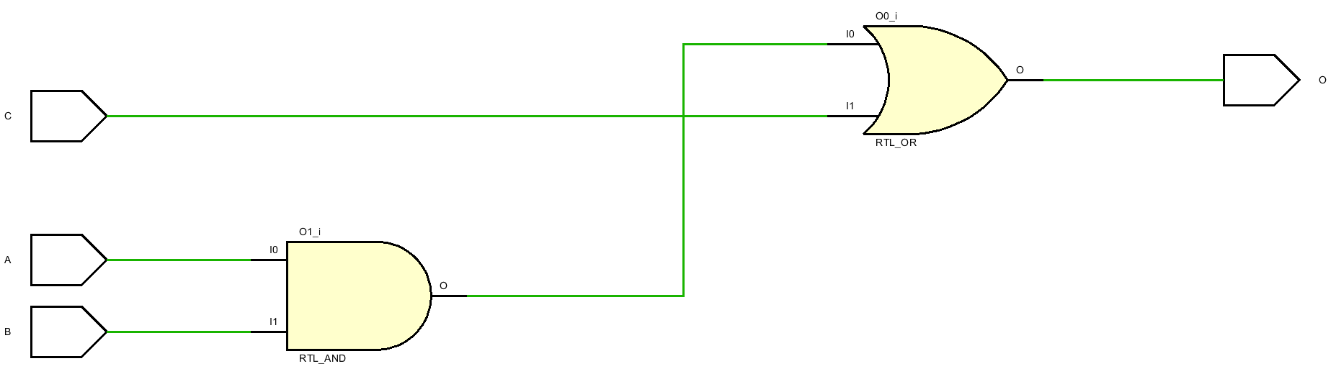
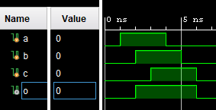
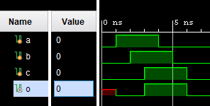
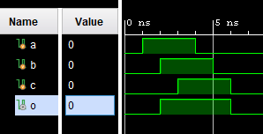
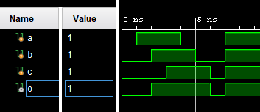
Blocking assignment – Good and bad styles
A
B
O
C
Behavioral
Behavioral
Good style
Bad style
reg r_and, r_or;
assign O = r_or;
always @ (A, B, C) begin
r_and = A & B;
r_or = r_and | C;
end //demo_2
reg r_and, r_or;
assign O = r_or;
always @ (A, B, C) begin
r_and <= A & B;
r_or <= r_and | C;
end //demo_2
Results
Mismatch!
(bug in front-end)
Results
Match!
(no bug)
Post-synth
Post-synth

Slide 18
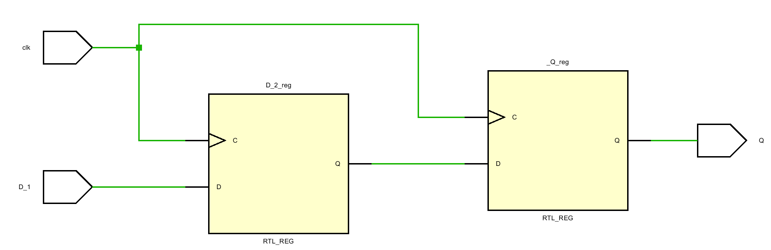
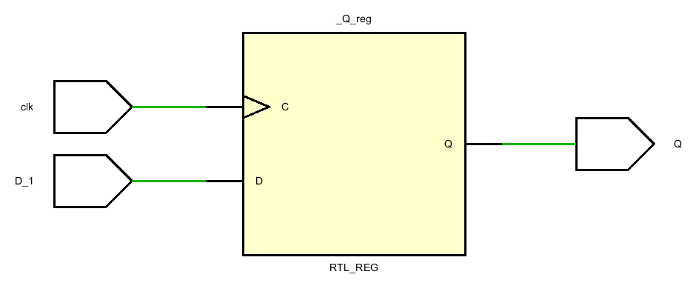
Non-blocking assignment – Good and bad styles
D_1
D_FF
D_2
D_FF
Q
clk
Good style
Bad style
reg D_2, _Q;
assign Q = _Q;
always @ (posedge clk) begin
D_2 <= D_1;
_Q <= D_2;
end //demo_3
reg D_2, _Q;
assign Q = _Q;
always @ (posedge clk) begin
D_2 = D_1;
_Q = D_2;
end //demo_3

Slide 19
Design pitfalls
Multi drive always module
Combinational loop

Slide 20

Multi-drive always blocks
always @ (a, b) begin
…
x = a | b;
…
end
always @ (c, d) begin
…
x = c & d;
…
end
Statements within always are evaluated sequentially from the first to the last.
However, different always blocks are executed randomly.
The execution order of the green and blue always are totally random run-to-run.
Rules of thumb No.4:
Each reg should only be driven by one always block.
Critical warning generated during synthesis.

Slide 21
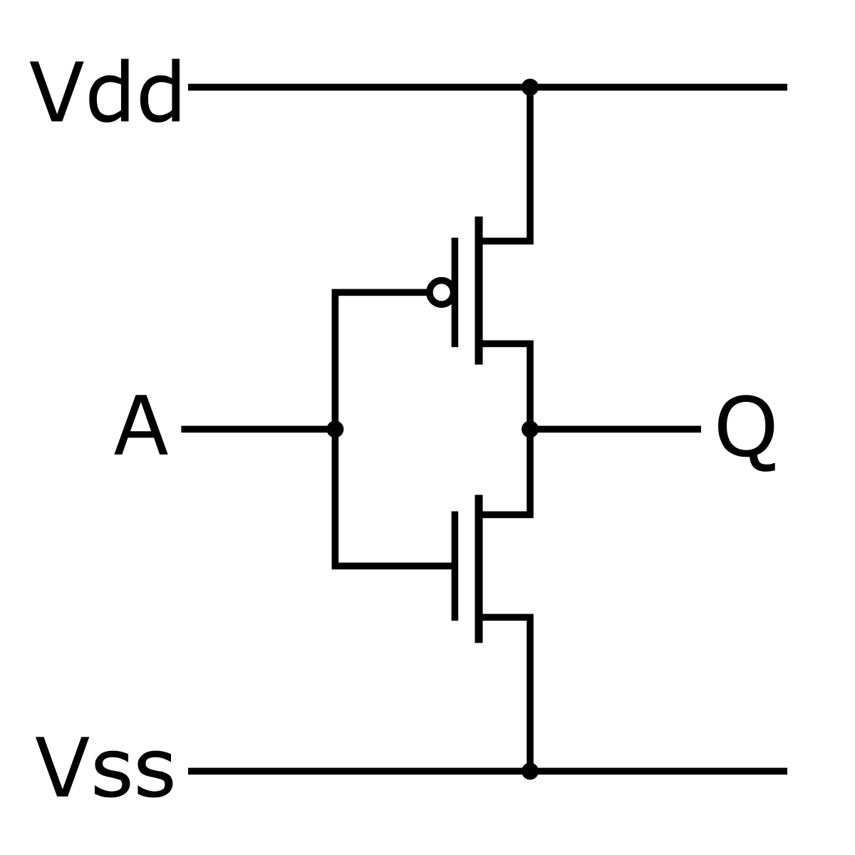
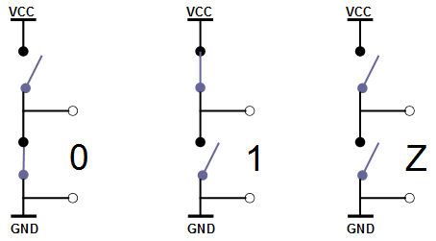
Bit-vector is the only data type in Verilog
A bit can take on one of four values
Value | Meaning
0 | Logic zero
Vdd
Vdd
Vdd
Vss
Vss
Vss

Slide 22
Bit-vector is the only data type in Verilog
A bit can take on one of four values
Value | Meaning
0 | Logic zero
1 | Logic one
Vdd
Vdd
Vdd
Vss
Vss
Vss

Slide 23
Bit-vector is the only data type in Verilog
A bit can take on one of four values
Value | Meaning
0 | Logic zero
1 | Logic one
Z | High impedance, floating
Vdd
Vdd
Vdd
Vss
Vss
Vss

Slide 24
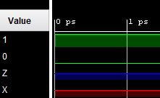
Bit-vector is the only data type in Verilog
A bit can take on one of four values
Value | Meaning
0 | Logic zero
1 | Logic one
Z | High impedance, floating
X | Unknown logic value
Vdd
Vdd
Vdd
An X bit might be a 0, 1, Z, or in transition. We can set bits to be X in situations where we don’t care what the value is. This can help catch bugs and improve synthesis quality (Lecture 5 – Verilog III).
Vss
Vss
Vss

Slide 25
Bit literals
Binary literals
2’b01 (01)
8’b0001_1111 (00011111)
-3’b1 (111)
Octal literals
6’o12 (001_010)
Hexadecimal literals
6’h1f (01_1111)
16’haxxz (1010_xxxx_xxxx_zzzz)
Decimal literals
4’d1 (0001)
-4’d1 (1111)
reg[3:0] a = 1; (0001)
reg[3:0] a = -1; (1111)
integer a = 1; (0000_0000_..._0001, 32-bit)
Integer a = -1; (1111_1111_..._1111, 32-bit)
4’b10_11
Underscores
are ignored
Base format
(B, O, H, D)
Decimal number
Representing size in bits

Slide 26
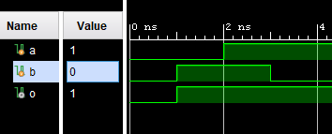
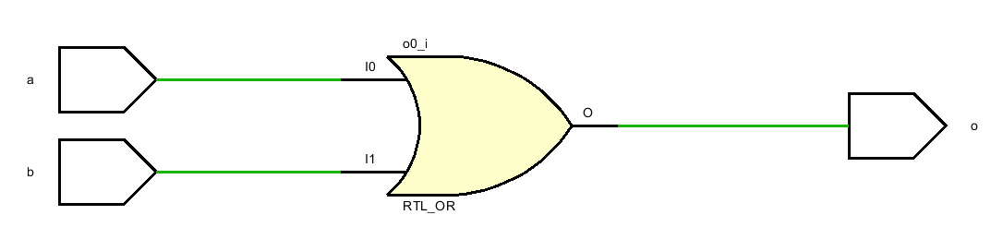
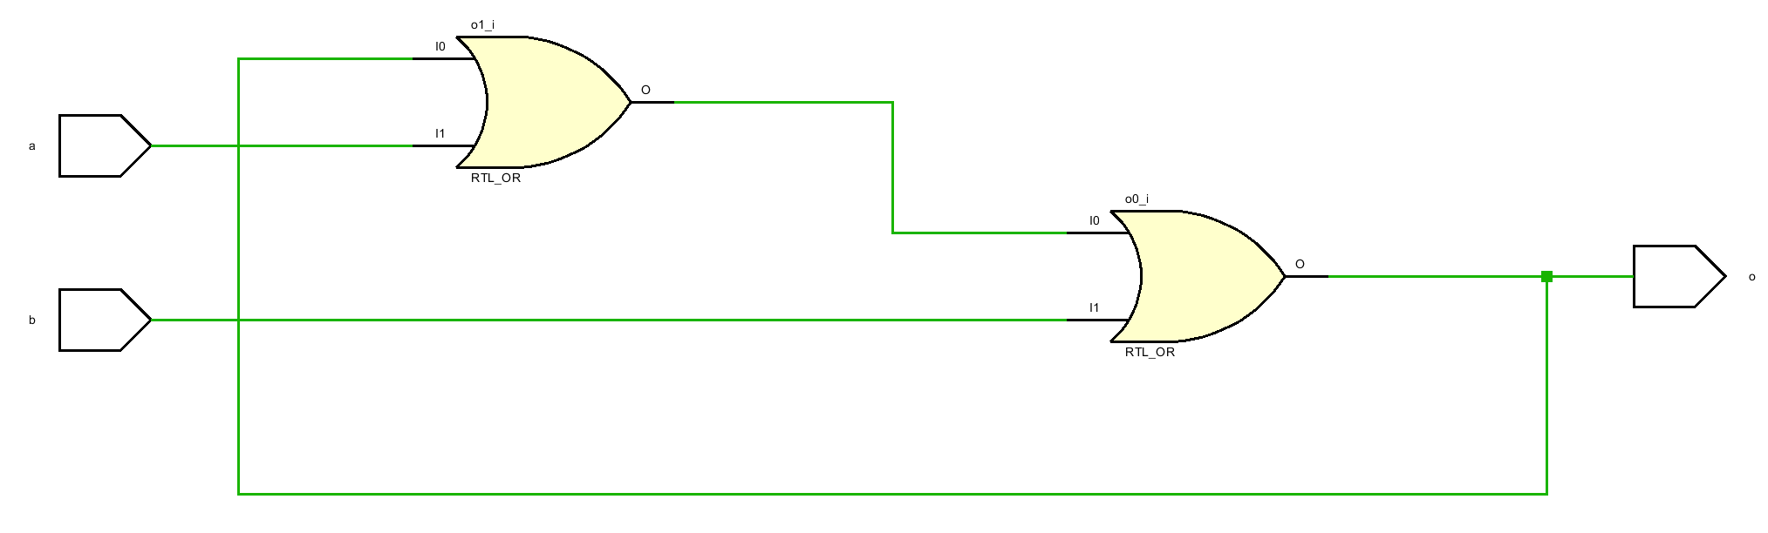
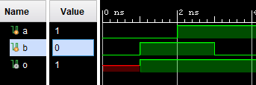
Combinational loop – the obvious case
Hard to use simulation results to detect combi-loop.
always @ (a, b)
begin
c = a | b;
end
Rules of thumb No.5:
Remember to check the Vivado methodology report at each step.
No error generated at both pre and post synthesis simulation.
But a non-critical warning is generated during synthesis.
always @ (a, b)
begin
c = a | b | c;
end //demo_4
Or an error message is generated during later bit stream generation.

Slide 27
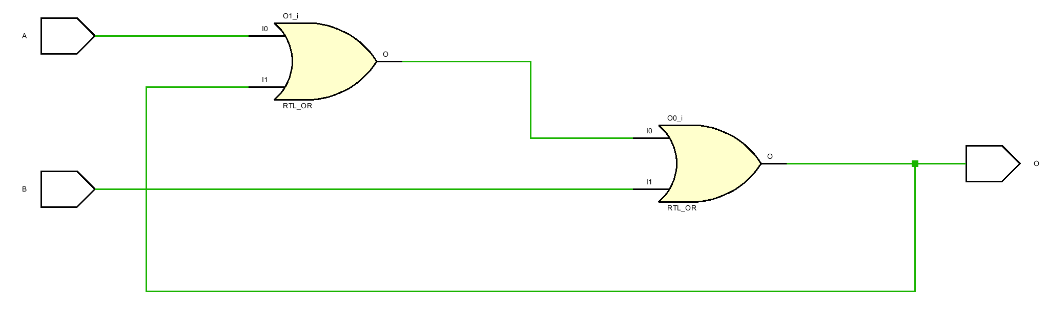
Combinational loop – the covert case
always @ (a, x) begin
…
y = a| x;
…
end
always @ (y, b) begin
…
x = y | b;
…
end
A combi-loop may hide within the ocean of gates in a large design.
y
x

Slide 28
Writing testbench using Verilog
Testbenches are used to test/debug Verilog design with synthetic inputs and collect the outputs.
Testbenches are usually top modules in a Verilog project.
The design-under-test is a sub-modules in a testbench module
Testbenches are not supposed to be synthesizable.
testbench
inputs
outputs
DUT/UUT

Slide 29
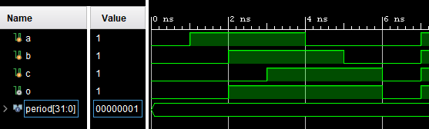
A testbench example
DUT.v
tb.v
What we get from DUT.v
module demo_2(A, B, C, O);
input A, B, C;
output O;
reg r_and, r_or;
assign O = r_or;
always @ (A, B, C) begin
r_and = A & B;
r_or = r_and | C;
end
Endmodule
`timescale 1ns/1ps
module tb;
reg a, b, c;
wire o;
demo_2 UUT(a, b, c, o);
localparam period = 1;
initial begin
a = 0; b = 0; c = 0;
#period;
a = 1; b = 0; c = 0;
#period;
a = 1; b = 1; c = 0;
. . .
end
endmodule
Top module, no input nor outpus
A
Instantiation
B
O
C
What we get from tb.v

Slide 30
What defines a good testbench and how to achieve them
Input coverage
As much different input patterns as possible
Loop statement
Reliability
Mimic the electronic properties of real-word signals
Timing control
Delay control
Edge sensitive event control
Level sensitive event control
Named event (Lecture 9 – Verification)
Reusability/readability
Functionalities encapsulation
Function and task

Slide 31
Loop statement
Verilog provides four ways to do loop
for
while
repeat
forever
Loop statements are synthesizable for iterations with finite values known at elaboration (compile) time
Loop statements are synthesized with hardware replication
Although possible but is it a bad practice
Loop statements are better match for test bench and verification

Slide 32
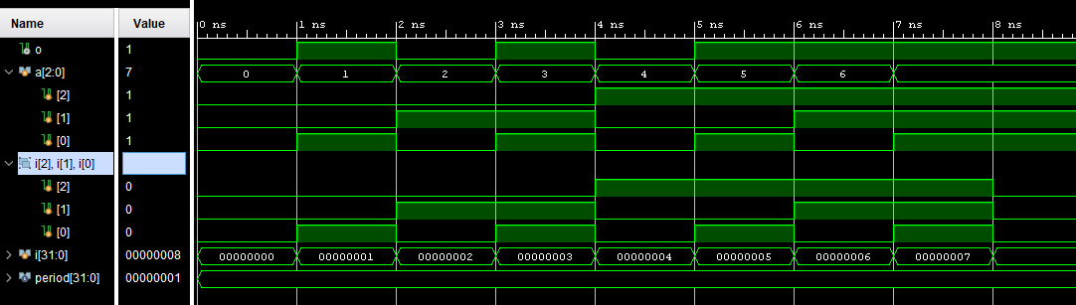
For loop statement
3-bit reg “a”, with MSB at the most left.
tb.v
tb.v
`timescale 1ns/1ps
module tb;
reg a, b, c;
wire o;
demo_5 UUT(a, b, c, o);
localparam period = 1;
initial begin
a = 0; b = 0; c = 0;
#period;
a = 1; b = 0; c = 0;
#period;
a = 1; b = 1; c = 0;
. . .
end
endmodule
What if the input contains 16 signals?
2¹⁶ lines!
`timescale 1ns/1ps
module tb;
reg [2:0] a;
wire o;
demo_5 UUT(a[2], a[1], a[0], o);
localparam period = 1;
integer i;
initial begin
for (i=0; i<8; i=i+1) begin
a = {i[2], i[1], i[0]};
#period;
end
end
endmodule
assign bit a[2] to the first port of UUT, and so on. That is:
a[2] to a, A[1] to b, A[0] to c.
The initial block is like the always block except that it is executed just once.
Interger data type (32-bit) i for loop counter.
Need 8 lines to exhaust all input patterns.
The loop body
Wrap up the last three bits of i using “{}” and assign them all to a.
This is equivalent to:
a[2] = i[2], a[1] = i[1], a[0]=i[0];

Slide 33
While and repeat loop statements
tb.v
tb.v
`timescale 1ns/1ps
module tb;
reg [2:0] a;
wire o;
demo_5 UUT(a[2], a[1], a[0], o);
localparam period = 1;
integer i;
initial begin
i=0;
while (i < 8) begin
i = i + 1;
a = {i[2], i[1], i[0]};
#period;
end
end
endmodule
`timescale 1ns/1ps
module tb;
reg [2:0] a;
wire o;
demo_5 UUT(a[2], a[1], a[0], o);
localparam period = 1;
integer i;
initial begin
i=0;
repeat (8) begin
i = i + 1;
a = {i[2], i[1], i[0]};
#period;
end
end
endmodule
Loop body
using
while
Loop body
using
repeat

Slide 34
Verilog operators
Operator | Name
[ ] | Bit-select
~ | Bit-Negation
& | Bit-AND
| | Bit-OR
~& | Bit-NAND
~| | Bit NOR
^ | Bit XOR
~^ or ~^ | Bit XNOR
Operator |  |  |  | Name
! |  |  |  | Logic-Negation
< | <= | >= | > | Logic-Comparison
== |  | != |  | Logic-Comparison
&& |  |  |  | Logic-AND
|| |  |  |  | Logic-OR
? : |  |  |  | Logic-Conditional
module replication_operator();
reg [3:0] r_VAL_1 = 4'b0111;
parameter c_MULTIPLIER = 4'b0010;
initial
begin
// Replication Only
$display("Replication of 0x7, 3 times is 0x%h",
{3{r_VAL_1}} );
// Replication is possible using a constant (parameter)
// Note that replication multiplier CANNOT be a reg
$display("Replication of 0x7, %1d times is 0x%h",
c_MULTIPLIER, {c_MULTIPLIER{r_VAL_1}} );
// Replication and Concatenation together
$display("Concatenate 4 with replication of 0xA twice: 0x%h",
{4'h4,{2{4'hA}}} );
// Replication and Concatenation 2
$display("Replicate the concatenation of 0xB and 0xC 4 times: 0x%h",
{4{4'hB, 4'hC}} );
#20;
$finish;
end
endmodule // replication_operator
Operator |  |  |  |  | Name
{ } |  |  |  |  | concatenate
{ { } } |  |  |  |  | replication
+ | - | * | / | % | Arithmetic
wire w_reduce;
assign w_reduce = ~&tmp[3:0]
Notes:
# Replication of 0x7, 3 times is 0x777
# Replication of 0x7, 2 times is 0x77
# Concatenate 4 with replication of 0xA twice: 0x4aa
# Replicate the concatenation of 0xB and 0xC 4 times: 0xbcbcbcbc
# ** Note: $finish : example_replication_operator.v(32)

Slide 35
Verilog timing control
There are four types of timing controls in Verilog
Delay control
Edge sensitive event control
Level sensitive event control
Named events

Slide 36
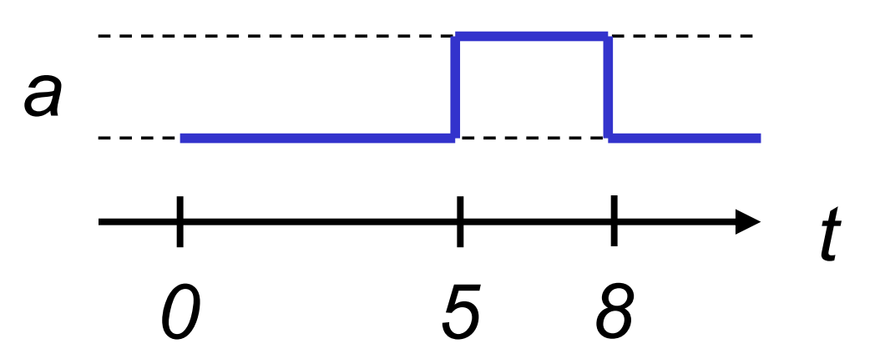
Delay control
Clock generator
Example 3
# N: delay of N time units
Example:
…
localparam period = 5;
reg clk;
initial begin
clk=0;
forever begin
#period clk = ~clk;
end
end
endmodule
Example 1
Example 2
always begin
a = 1’b0;
#5;
a = 1’b1;
#3;
a=1’b0;
end
…
localparam period = 1;
integer i;
initial begin
i=0;
while (i < 8) begin
i = i + 1;
a = {i[2], i[1], i[0]};
#period;
end
end
endmodule
Delay can be controlled using local var.
Delay for 1 unit time at the end of each loop iteration.

Slide 37
Delay control – Time unit
`timescale time_unit base / precision base
The first argument specifies “#1” delay
The second argument specifies the how delay values are rounded
Base is in
s 1s
ms 1⁻³s
us 1⁻⁶s
ns 1⁻⁹s
ps 1⁻¹²s
fs 1⁻¹⁵s
Example
`timescale 1ns/1ns
Delay Meaning Sim. Time
#1 // Delay 1 ns 1
#0.49 // Delay 0 ns 1
#0.5 // Delay 1 ns 2
#0.51 // Delay 1 ns 3
#5 // Delay 5 ns 8

Slide 38
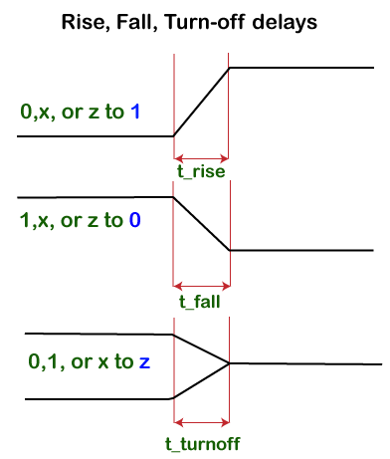
Delay control – Gate delay
So far, we have assumed perfect signal response time
It takes no time for signal to change from 0 to 1
It takes no time for signal to change from 1 to 0
This cannot be true in real life where the electronic properties of gates take effect
Three kinds of delays
Rise delay The time taken for the output of a gate to change from 0,x,z, to 1 is called a rise delay.
Fall delay The time taken for the output of a gate to change from 1,x,z, to 0 is called a fall delay.
Turn-off delay The time taken for the output of a gate to change from 0,1,x, to z is called a turn-off delay.

Slide 39
Delay control – Gate delay
Verilog uses # to control rise/fall/turn-off delay of signals
Let’t talk about gate delay of an “and” gate
and and1(o,a,b) // Ideal “and” gate
and #1 and1(o,a,b) // All delays
and #(1,1) and1(o,a,b) // t_rise=1, t_fall=1
and #(1,2,3) and1(o,a,b) // t_rise=1, t_fall=2, t_off=3
and #(1:2:3,2:3:4,3:4:5) and1(o,a,b) // min:typ:max
Gate delays are used in post-synthesis timing simulation, where only the gate delays of the gate library vendor are used.
Min |  |  | Typ |  |  | Max
t_rise | t_fall | t_max | t_rise | t_fall | t_max | t_rise | t_fall | t_max
1 | 2 | 3 | 2 | 3 | 4 | 3 | 4 | 5
The default choice

Slide 40
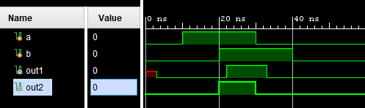
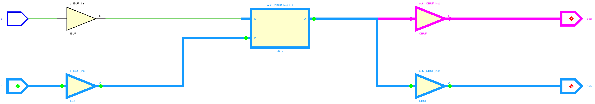
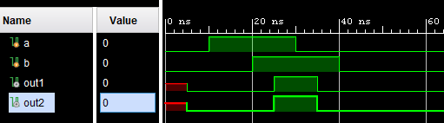

Gate delay example
Pre-synthesis behavioral simulation
module demo_6( input a, b, output out1, out2);
and #(1:2:3, 2:3:4) and1 (out1, a, b);
and and2 (out2, a, b);
endmodule
module tb;
reg a,b;
wire out1, out2;
demo_6 UUT(a, b, out1, out2);
initial begin
{a, b} <= 0;
#10 a <= 1;
#10 b <= 1;
#10 a <= 0;
#10 b <= 0;
end
endmodule
2ns
0ns
3ns
0ns
Post-synthesis timing simulation
~5ns
~5ns

Slide 41
Edge sensitive event control
A statement happens only when the posedge and/or negedge event happens
Can be attached to sensitivity list of an “always” block always @ (posedge clk);
Execute the always block at each rising edge of signal “clk”
Or to individual assignments @ (posedge clk) X <= Y;
Delay assignment X<=Y until the positive edge of “clk”. X <= @ (posedge clk) Y;
Read y immediately but delay the assignment to posedge “clk”.
At positive and/or negative edges @(posedge x and negedge y) @(posedge x or negedge y)

Slide 42
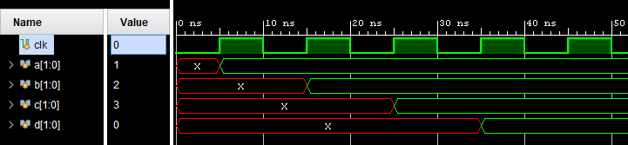
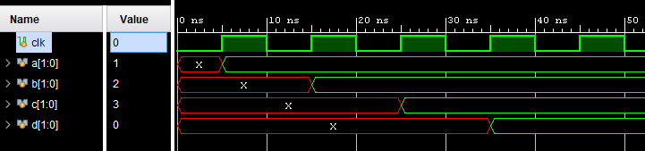
Edge sensitive event control
module tb; //demo_7
reg clk;
reg [2:0] a, b, c, d;
initial begin
clk = 0;
forever begin
#5 clk = ~clk;
end
end
always begin
@(posedge clk) a=3'd1;
@(posedge clk) b=3'd2;
@(posedge clk) c=3'd3;
@(posedge clk) d=3’d4;
$display("time is %0t",$time);
end
endmodule
module tb; //demo_7
reg clk;
reg [3:0] a, b, c, d;
initial begin
clk = 0;
forever begin
#5 clk = ~clk;
end
end
always begin
@(posedge clk) a<=3'd1;
@(posedge clk) b<=3'd2;
@(posedge clk) c<=3'd3;
@(posedge clk) d<=3’d4;
$display("time is %0t",$time);
end
endmodule
time is 35 ns
time is 75 ns
time is 115 ns
time is 155 ns
time is 195 ns
time is 235 ns
time is 275 ns
time is 315 ns
time is 355 ns
time is 395 ns
time is 435 ns
time is 35 ns
time is 75 ns
time is 115 ns
time is 155 ns
time is 195 ns
time is 235 ns
time is 275 ns
time is 315 ns
time is 355 ns
time is 395 ns
time is 435 ns

Slide 43
Level sensitive event control
@(X, Y)
A block will be executed each time a variable changes its value
@* or @(*)
A block will be executed at change of any variable that is read in its scope
Always use blocking assignment “=” inside @*/@(*)
wait( )
A block will be executed until a condition becomes true within the wait() function.

Slide 44
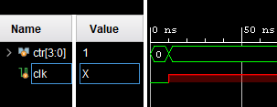
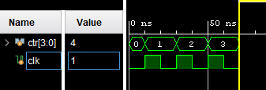
Example of wait()
module tb;
reg [3:0] ctr;
reg clk;
initial begin
{ctr, clk} <= {4’b0000, 1’b0};
wait (ctr);
$display ("T=%0t Counter reached non-zero value 0x%0h", $time, ctr);
wait (ctr == 4’b0100)
$display ("T=%0t Counter reached 0x%0h", $time, ctr);
$finish;
end
always clk = #10 ~clk;
always @ (posedge clk)
ctr <= ctr + 1;
endmodule
Initial block first
Trigger order
Trigger order
A hideous bug here
Executed at simulation time 0. {ctr, clk} <=0
10 UT: execute the first $display.
Blocked until crt is 4
70 UT: execute the second $display.
Simulation finishes.
Blocked until ctr is non-zero.
Should be =, not <=
Executed at simulation time 0.
Blocked for 10 UT.
10 UT: clk = 1
Blocked for 10 UT.
20 UT: clk = 0
Blocked for 10 UT.
Executed at simulation time 0.
70 UT: clk = 1
Blocked for 10 UT.
Blocked until posedge clk.
10 UT: ctr = 1
Wait for posedge.
70 UT: ctr = 4
Blocked for 10 UT.
Notes:
always clk = #10 ~clk;
Reads the unitialized value of clk at timestamp 0 since clk is assigned using non-blocking
Assignment in the initial block

Slide 45
Verilog function vs task
Verilog provides function and task for code reuse.
Help to improve reusability readability in large projects.
They are similar but differ in many aspects.

Slide 46
Verilog function vs task
Verilog provides function and task for code reuse.
Help to improve reusability readability in large projects.
They are similar but differ in many aspects.
 | Function | Task
1 | Do not allow initial or always block.

Slide 47
Verilog function vs task
Verilog provides function and task for code reuse.
Help to improve reusability readability in large projects.
They are similar but differ in many aspects.
 | Function | Task
1 | Do not allow initial or always block.
2 | A function takes 0 simulation time to execute. | A task takes arbitrary simulation time to execute depending on the timing control statements within.

Slide 48
Verilog function vs task
Verilog provides function and task for code reuse.
Help to improve reusability readability in large projects.
They are similar but differ in many aspects.
 | Function | Task
1 | Do not allow initial or always block.
2 | A function takes 0 simulation time to execute. | A task takes arbitrary simulation time to execute depending on the timing control statements within.
3 | A function cannot contain timing control statements such as: # delay, posedge, negedge, etc. | A task can contain timing control statements.

Slide 49
Verilog function vs task
Verilog provides function and task for code reuse.
Help to improve reusability readability in large projects.
They are similar but differ in many aspects.
 | Function | Task
1 | Do not allow initial or always block.
2 | A function takes 0 simulation time to execute. | A task takes arbitrary simulation time to execute depending on the timing control statements within.
3 | A function cannot contain timing control statements such as: # delay, posedge, negedge, etc. | A task can contain timing control statements.
4 | A function can call other functions but can not call tasks. (Because of Rule 2 & 3) | A task can call other functions or tasks. (Because of rule 2 and 3)

Slide 50
Verilog function vs task
Verilog provides function and task for code reuse.
Help to improve reusability readability in large projects.
They are similar but differ in many aspects.
 | Function | Task
1 | Do not allow initial or always block.
2 | A function takes 0 simulation time to execute. | A task takes arbitrary simulation time to execute depending on the timing control statements within.
3 | A function cannot contain timing control statements such as: # delay, posedge, negedge, etc. | A task can contain timing control statements.
4 | A function can call other functions but can not call tasks. (Because of Rule 2 & 3) | A task can call other functions or tasks. (Because of rule 2 and 3)
5 | A function must have at least one input argument but cannot have output arguments. | A task can have any number (zero or more) of input and output ports.

Slide 51
Verilog function vs task
Verilog provides function and task for code reuse.
Help to improve reusability readability in large projects.
They are similar but differ in many aspects.
 | Function | Task
1 | Do not allow initial or always block.
2 | A function takes 0 simulation time to execute. | A task takes arbitrary simulation time to execute depending on the timing control statements within.
3 | A function cannot contain timing control statements such as: # delay, posedge, negedge, etc. | A task can contain timing control statements.
4 | A function can call other functions but can not call tasks. (Because of Rule 2 & 3) | A task can call other functions or tasks. (Because of rule 2 and 3)
5 | A function must have at least one input argument but cannot have output arguments. | A task can have any number (zero or more) of input and output ports.
6 | A function can return a single value. | A task cannot return a value but can achieve the same effect using output arguments.

Slide 52
Verilog function vs task
Verilog provides function and task for code reuse.
Help to improve reusability readability in large projects.
They are similar but differ in many aspects.
 | Function | Task
1 | Do not allow initial or always block.
2 | A function takes 0 simulation time to execute. | A task takes arbitrary simulation time to execute depending on the timing control statements within.
3 | A function cannot contain timing control statements such as: # delay, posedge, negedge, etc. | A task can contain timing control statements.
4 | A function can call other functions but can not call tasks. (Because of Rule 2 & 3) | A task can call other functions or tasks. (Because of rule 2 and 3)
5 | A function must have at least one input argument but cannot have output arguments. | A task can have any number (zero or more) of input and output ports.
6 | A function can return a single value. | A task cannot return a value but can achieve the same effect using output arguments.
7 | A function can be called in an expression or can be called with a statement (disconnected function). (Because of Rule 5 and 6) | A task must be specifically called with a statement. (Because of Rule 5 and 6)
Rules of thumb No.6:
Use function to model combi-logic.
Use task to model either combi- or sequential logic.

Slide 53
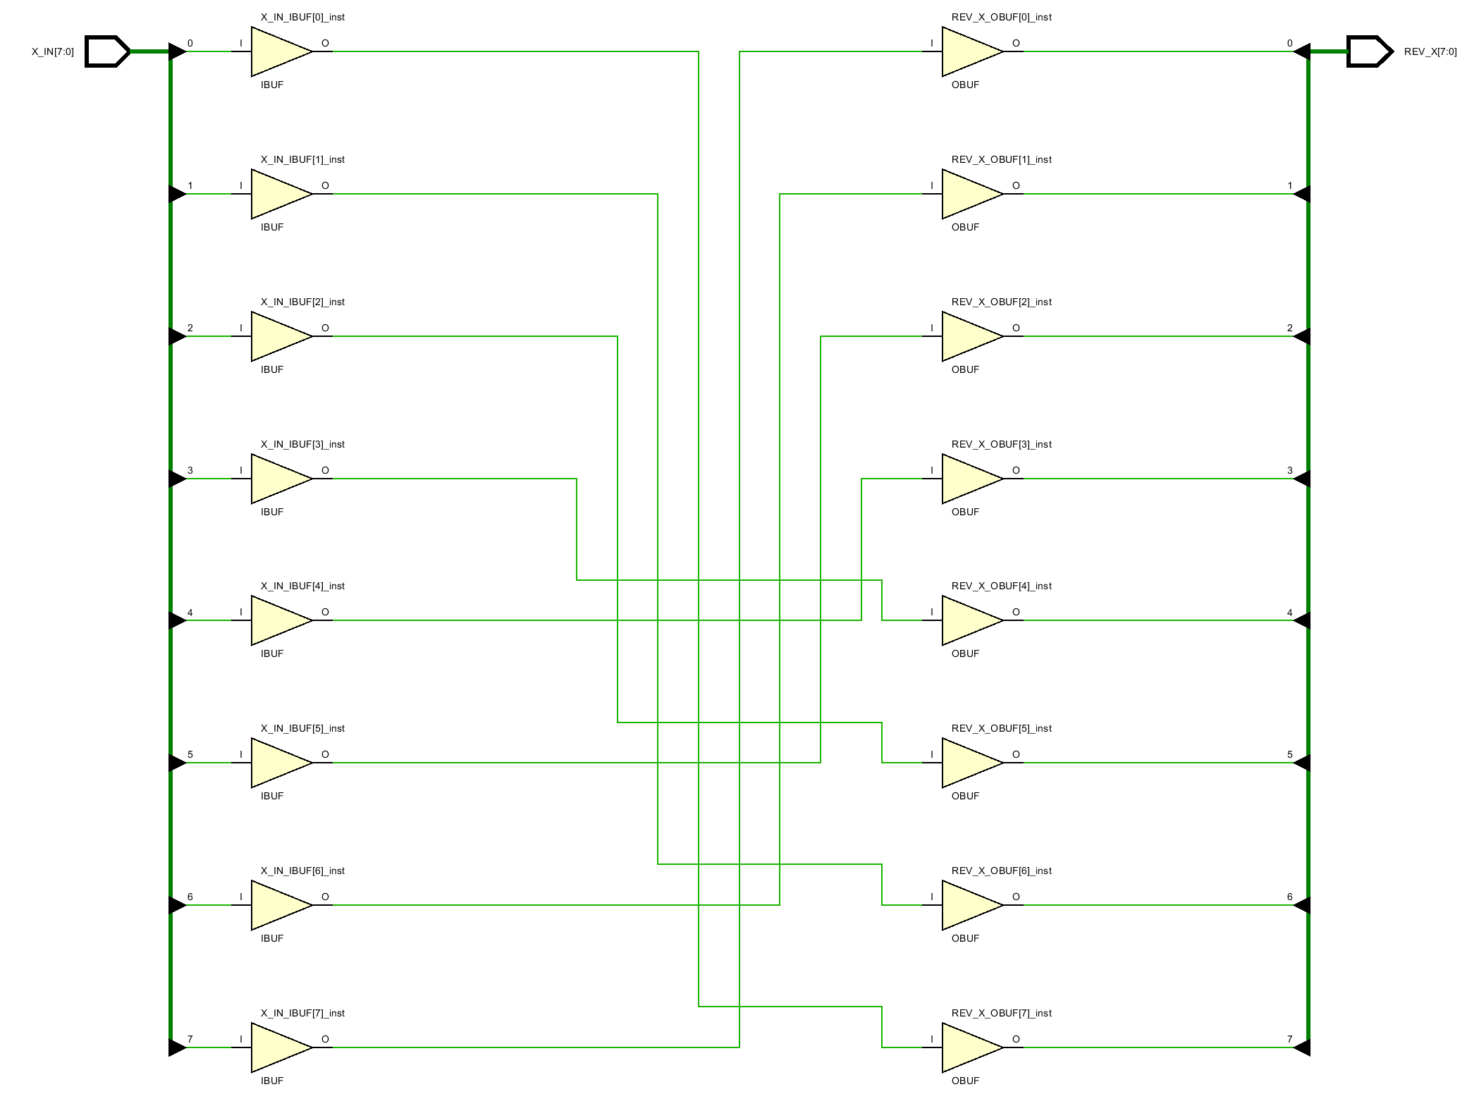
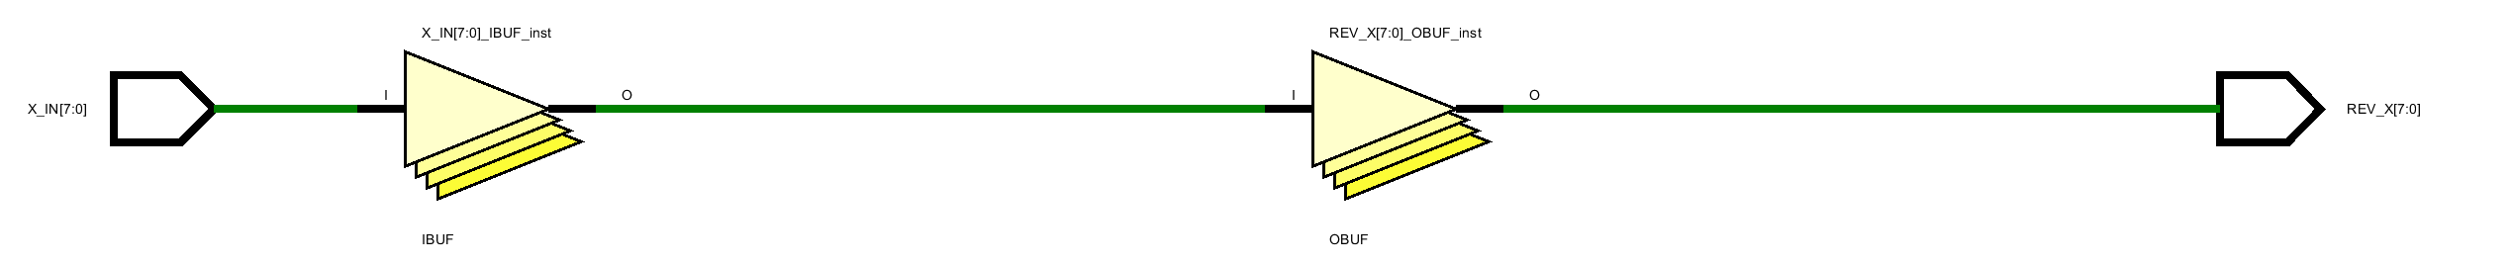
module has_function (x_in, rev_x); //demo_9
parameter maxbits = 8;
input [maxbits - 1 : 0] x_in;
output reg [maxbits - 1 : 0] rev_x;
function [maxbits - 1 : 0] reverse_bits;
input [maxbits - 1 : 0] din;
integer k;
begin
for (k=0; k < maxbits; k = k +1)
reverse_bits[maxbits-1-k] = din[k];
end
endfunction
always @ (x_in)
rev_x = reverse_bits(x_in);
endmodule
module has_task (x_in, rev_x); //demo_9
parameter maxbits = 8;
input [maxbits - 1 : 0] x_in;
output reg [maxbits - 1 : 0] rev_x;
task reverse_bits;
input [maxbits - 1 : 0] din;
output [maxbits - 1 : 0] dout;
integer k;
begin
for (k=0; k < maxbits; k = k +1)
dout[maxbits-1-k] = din[k];
end
endtask
always @ (x_in)
reverse_bits(x_in, rev_x);
endmodule
function name is the implicit output reg name.
Don’t declare your local reg with the same name!

Slide 54

Questions?

